Slide 1
Software Requirements Engineering
Lecture 5
Customer-Developer Partnership

Slide 2
Contents
Expectation gap
Customer, Stakeholder and User
Customer-Developer Partnership
Requirements Bill of Rights for Software Customers
Requirements Bill of Responsibilities for Software Customers
Creating a culture that respects requirements
Identifying decision makers
Reaching agreement on requirements
The requirements baseline
Agreeing on Requirements in Agile Projects

Slide 3
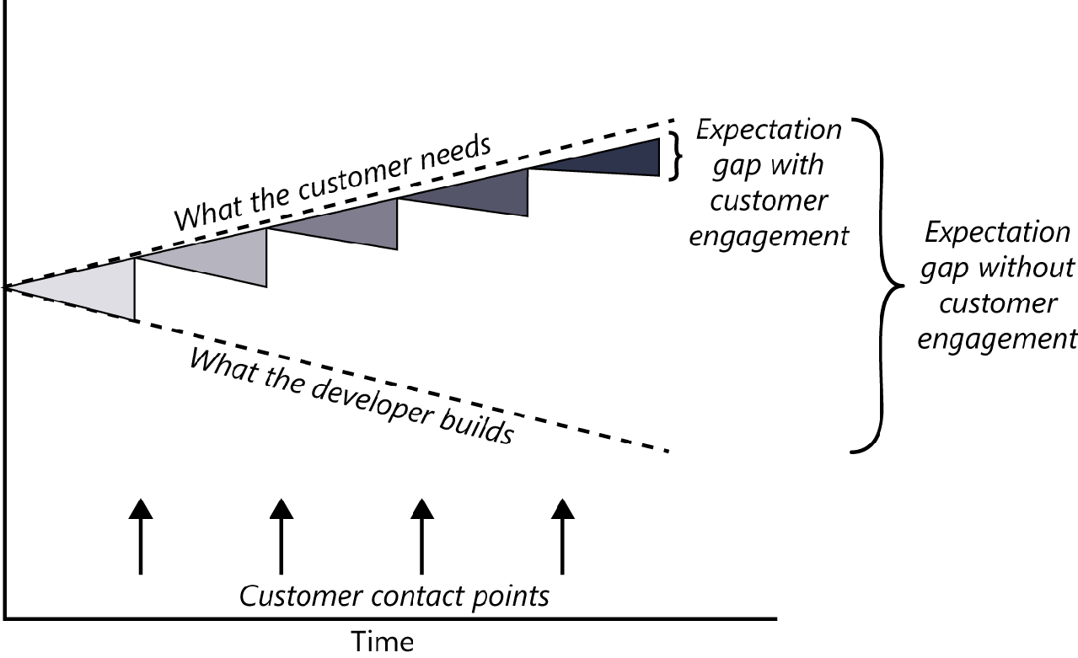
Expectation Gap - Definition
Expectation gap is a gulf between what customers really need and what developers deliver based on what they heard at the beginning of the project (Wiegers 1996).
Due to insufficient user involvement
The pictorial representation
Of Expectation Gap

Slide 4
Expectation Gap – How to minimize it
The best way to minimize the expectation gap is to arrange frequent contact points with suitable customer representatives.
interviews, conversations, requirements reviews, user interface design walkthroughs, prototype evaluations
feedback on small increments of executable software (in case of agile methods)
Contact points ensure that what the developer builds is more closely aligned with what the customer needs.

Slide 5
2. Stakeholder, Customer, User 2.1 Stakeholder
A stakeholder is a person, group, or organization that is actively involved in a project, is affected by its process or outcome, or can influence its process or outcome.
Stakeholders can be internal or external to the project team and to the developing organization.
Have candidate stakeholder list first and then filter it down to the core set whose input you really need, to make sure you understand all of the project’s requirements and constraints so your team can deliver the right solution.

Slide 6
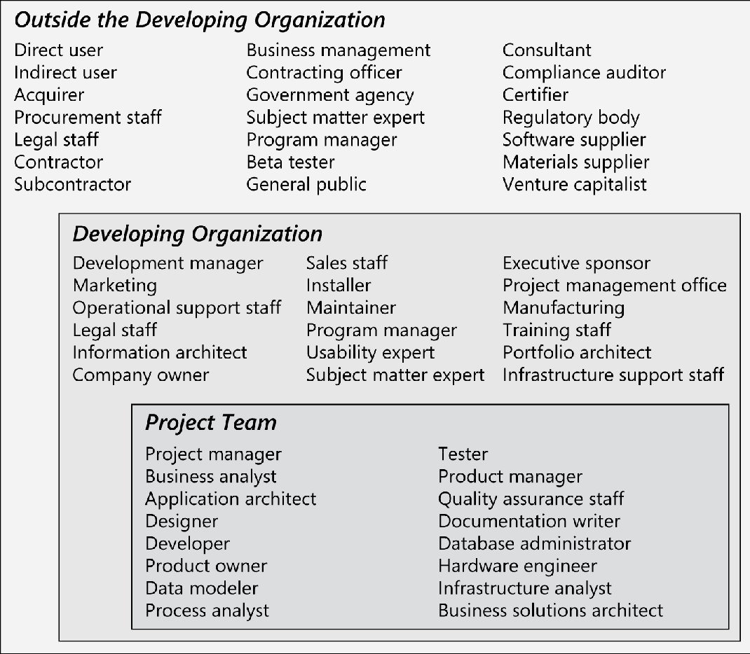

Slide 7
2.2 Customer
Customers are a subset of stakeholders.
A customer is an individual or organization that derives either direct or indirect benefit from a product.
Software customers could request, pay for, select, specify, use, or receive the output generated by a software product.
Business Requirements come from the customers.

Slide 8
2.3 User
Users (often called end users) are the people who will actually use the product. These users are a subset of customers.
User requirements should come from these users.
Direct users will operate the product hands-on.
Indirect users might receive outputs from the system without touching it themselves, such as a warehouse manager who receives an automatic report of daily warehouse activities by email.
If there is a serious disconnect between the acquiring customers who are paying for the project and the end users, major problems are guaranteed.
For commercial software development, the customer and the user often are the same person.
Customer surrogates, such as marketing personnel or a product manager, typically attempt to determine what customers would find appealing.
Without the user involvement, be prepared to read reviews pointing out product shortcomings that adequate user input could have avoided.

Slide 9
Conflicts among Stakeholders
Conflicts can arise among project stakeholders.
Business requirements sometimes reflect organizational strategies or budgetary constraints that aren’t apparent to users.
To manage such potential conflicts, try communication strategies about project objectives and constraints that can avoid debates and hard feelings.

Slide 10
The customer-developer partnership
Excellent Software Product
Well-Executed Design
Excellent Requirements
Effective Collaboration b/w developers and customers

Slide 11
Requirements Bill of Rights for Software Customers
Expect BAs to speak your language.
Expect BAs to learn about your business and your objectives.
Expect BAs to record requirements in an appropriate form.
Receive explanations of requirements practices and deliverables.
Change your requirements.
Expect an environment of mutual respect.
Hear ideas and alternatives for your requirements and for their solution.
Describe characteristics that will make the product easy to use.
Hear about ways to adjust requirements to accelerate development through reuse.
Receive a system that meets your functional needs and quality expectations.

Slide 12
Requirements Bill of Responsibilities for Software Customers
Educate BAs and developers about your business.
Dedicate the time that it takes to provide and clarify requirements.
Be specific and precise when providing input about requirements.
Make timely decisions about requirements when asked.
Respect a developer’s assessment of the cost and feasibility of requirements.
Set realistic requirement priorities in collaboration with developers.
Review requirements and evaluate prototypes.
Establish acceptance criteria.
Promptly communicate changes to the requirements.
Respect the requirements development process.

Slide 13
Creating a culture that respects requirements
BAs, developers, and customers all should be engaged in a collaborative requirements partnership.
Understanding why people resist participating in requirements development is the first step to being able to address it.
The customers may haven’t been exposed to solid requirements practices or they might have suffered from poor implementation of requirements processes, perhaps working on a project that produced a large, incomplete, and ignored requirements specification.
The developers may not see the rework due to bad requirements as a serious inefficiency.
Being a BA, you have to make both the customers and the developers understand the need for a collaboration.
Express the cost in units that are meaningful to the organization, be it dollars, time, customer dissatisfaction, or lost business opportunities.
Show the development managers how poor requirements slow down design and lead to excessive—and expensive—course corrections.

Slide 14
Role of Developers and Testers in Requirements Process
Developers can offer valuable suggestions such as
easier ways to do certain things;
functionality that would be very time-consuming to implement;
unnecessary imposed design constraints;
missing requirements, such as how exceptions should be handled;
creative opportunities to take advantage of technologies.
Quality assurance staff and testers are likely to find many ambiguities, conflicts, and concerns with the requirements as they are developing their test cases and scenarios from the requirements.
Testers can also provide input on specifying verifiable quality attribute requirements.

Slide 15
Identifying decision makers
Decisions need to be made to resolve some conflict, accept (or reject) a proposed change, or approve a set of requirements for a specific release.
Early in your project, determine who the requirements decision makers will be and how they will make decisions
There’s no single correct answer as to who should make key decisions. A small group representing key areas—such as management, customers, business analysis, development, and marketing—generally works best.

Slide 16
Identifying decision makers
The decision-making group needs to identify its decision leader and to select a decision rule, which describes how they will arrive at their decisions. There are numerous decision rules to choose from, including the following:
The decision leader makes the choice, either with or without discussion with others.
The group votes and the majority rules.
The group votes, but the result must be unanimous to approve the decision.
The group discusses and negotiates to reach a consensus. Everyone can live with the decision and commits to supporting it.
The decision leader delegates authority for making the decision to one individual.
The group reaches a decision, but some individual has veto authority over that decision.
There is no globally correct or appropriate decision rule.

Slide 17
Reaching agreement on requirements
Reaching agreement on the requirements for the product to be built, or for a specific portion of it, is at the core of the customer-developer partnership.
Multiple parties are involved in this agreement:
Customers agree that the requirements address their needs.
Developers agree that they understand the requirements and that they are feasible.
Testers agree that the requirements are verifiable.
Management agrees that the requirements will achieve their business objectives.

Slide 18
Reaching agreement on requirements
All participants in the requirements approval process should know exactly what sign-off means or problems could ensue.
On the customer side, the customer representative or manager may regard signing off on the requirements as a meaningless ritual which may result into expectation gap.
On the development side, the manager may view sign-off as a way to freeze the requirements.
Both of these attitudes ignore the reality that it’s impossible to know all the requirements early in the project and that requirements will undoubtedly change over time.
Approving a set of requirements is an appropriate action that brings closure to some stage of requirements development.
The participants have to agree on precisely what they’re saying with their signatures.

Slide 19
The requirements baseline
Important concept is that of establishing a baseline of the requirements agreement, a snapshot of it at a point in time (Wiegers 2006).
A requirements baseline is a set of requirements that has been reviewed and agreed upon and serves as the basis for further development.
Whether your team uses a formal sign-off process or some other means of reaching agreement on requirements, the subtext of that agreement should read something like this:
“I agree that this set of requirements represents our best understanding of the requirements for the next portion of this project and that the solution described will meet our needs as we understand them today. I agree to make future changes in this baseline through the project’s defined change process. I realize that changes might require us to renegotiate cost, resource, and schedule commitments.”

Slide 20
The requirements baseline
A meaningful baselining process gives all the major stakeholders confidence in the following ways:
Customer management or marketing is confident that the project scope won’t explode out of control, because customers manage the scope change decisions.
User representatives have confidence that the development team will work with them to deliver the right solution, even if they didn’t think of every requirement before construction began.
Development management has confidence because the development team has a business partner who will keep the project focused on achieving its objectives and will work with development to balance schedule, cost, functionality, and quality.
Business analysts and project managers are confident that they can manage changes to the project in a way that will keep chaos to a minimum.
Quality assurance and test teams can confidently develop their test scripts and be fully prepared for their project activities.
After the decision makers define a baseline, the BA should place the requirements under change control.

Slide 21
What if you don’t reach agreement?
It can be hard to achieve sign-off from all the relevant stakeholders.
Issues of logistics, busy schedules, and people who are reluctant to commit and be held accountable later, people who think signing off will not allow them to demand changes in future.
Many teams have tried sending out an email message that says, “If you don’t reply by next Friday with your changes and/or sign-off, I’m going to assume you are agreeing to these requirements.”
That’s one option, but really it equates to not reaching agreement and it risks straining the relationship.
Try to understand why they didn’t feel comfortable with a sign-off and address that directly.
Document the fact that certain stakeholders didn’t sign off on the requirements in your risk list, along with the likely impact of some of the requirements being missing or wrong.
Follow up with these people as part of risk management.

Slide 22
Agreeing on requirements on agile projects
Agile projects generally maintain requirements in the form of user stories in a product backlog.
The product owner and the team reach agreement on what stories will be developed in the next iteration in a planning session.
The set of stories is chosen based on their priority and the team’s velocity (productivity).
After that set has been established and agreed to, the stories contained in the iteration are frozen.
Requested changes that come in are considered for future iterations.
There’s no attempt on an agile project to achieve stakeholder approval on the full scope of requirements for the project up front, however. In agile projects the full set of functionality is identified over time, although the vision and other business requirements do need to be established at the outset.

